Slide 1
OPTIMIZING ROAD TRAFFIC MANAGEMENT THROUGH AUTOMATED VIDEO ANNOTATION WITH COMPUTER VISION
Project Proposal Presentation
by
Swastik Banerjee (2348566)
Project Guide
Dr. Gobi R
Department of Computer Science
CHRIST(Deemed to be University), Bengaluru-29

Slide 2
AGENDA
Introduction
Alignment with SDG Goals
Existing Systems
Proposed System
Feasibility Analysis
Benefits of Proposed System
Plan of Work
References

Slide 3
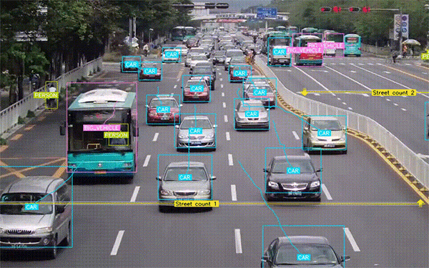
1. Introduction
Project Idea : Use Computer Vision to automate video annotation of live traffic movement.
Tasks involved : Object Detection, Intent Prediction, Road Segmentation, Accident Detection, Vehicle
Queue Length Estimation, Vehicle Speed Detection, Traffic Light Detection, Traffic
Sign Detection, Parking Spot Identification, General Surveillance.
Goal : Building a comprehensive system for smart city traffic management.

Slide 4
Requirement Analysis : Road traffic management is a pivotal element in shaping smart and
sustainable cities. The need for such a system is there in the market
if can be developed under a fixed budget and if it can be operated at an affordable
cost. The system needs to be “feasible” in one word.
Viability : The proposed methodology (to be discussed) is practical considering the Deep Learning
models we incorporate. Most of the models are fast and hence time saving and computationally
efficient. Also going by our timeline of completion of the project, it is even paced.
Novelty : At the heart of our research lies a commitment to originality and innovation. The proposed
project seeks to bridge existing gaps in the field of traffic management through the application
of advanced computer vision techniques. The uniqueness in our approach promises to set
standards.
Relevance : As cities worldwide strive to become smarter and more sustainable, effective traffic management
emerges as a linchpin in achieving these goals. Our research aims to be a catalyst for positive
change, aligning with the evolving landscape of smart city development.
:

Slide 5

2. Alignment with SDG Goals
Alignment with SDG 11: Sustainable Cities and Communities
Objective : Making inclusive, safe, resilient, and sustainable
cities.
Our Research Contribution : Utilizing cutting-edge technology for optimized road traffic management
– a crucial facet of urban development.
Addressing Specific Aspects of SDG 11 :
Enhanced Traffic Flow:
Real-time object detection, surveillance, and road monitoring is carried out.
Contribution to smart cities with improved traffic flow and reduced congestion.
Road Safety and Accident Prevention:
Intent prediction, online visual tracking, accident detection cater to road safety.
This directly addresses SDG 11 for ensuring safety in urban environments.
Efficient Resource Utilization:
Vehicle re-identification,queue length estimation,traffic sign detection boosts efficiency.
Aiming to optimize resource utilization for sustainable urban development.

Slide 6

3. Existing Systems (Overview)
We’ll have a quick look at how the existing Computer Vision models in the domain carry out tasks
related to Road Traffic Management in our next slide. The models mentioned although can’t be
compared among each other, as they all carry out different sub-tasks to make up singular task of
Traffic Management possible. It is Divide & Conquer Strategy being implemented in the area of
Computer Vision.

Slide 7
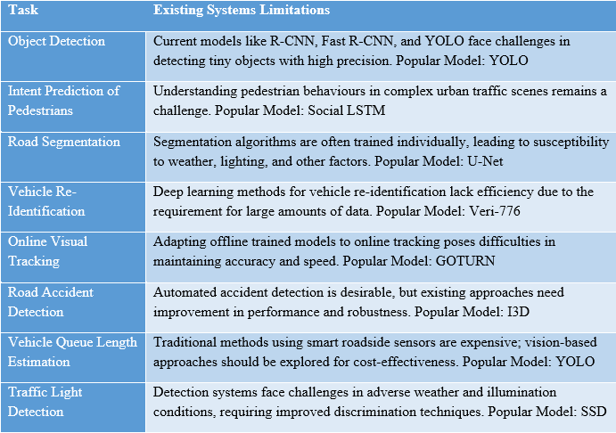

Slide 8
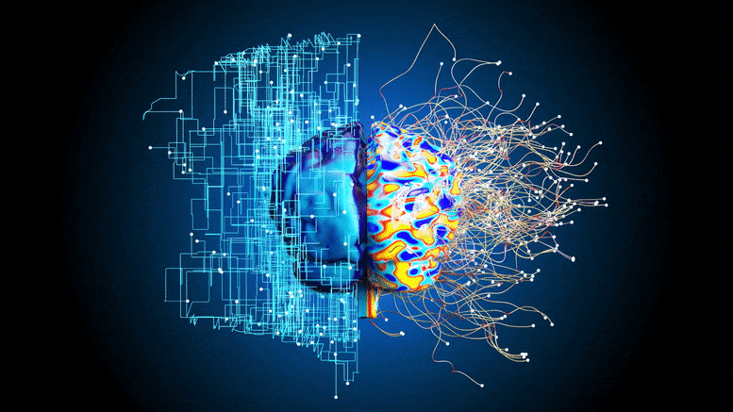
4. Proposed System (Description)

Slide 9

Functional Description
Object Detection with Enhanced YOLOv2 Algorithm:
Utilizes an enhanced YOLOv2 algorithm with integrated DenseNet-201 for precise vehicle detection in surveillance videos, ensuring high precision, even for tiny objects.
Intent Prediction of Pedestrians using Real-time Framework:
Employs a real-time framework with a tracking-by-detection technique and a spatio-temporal DenseNet model for accurate detection, tracking, and prediction of pedestrian actions in urban traffic environments.
End-to-End CNN Model for Drivable Area Segmentation:
Introduces Dense-ACSSD, an end-to-end CNN model trained on the BDD100K dataset for drivable area segmentation and multiple object detection, meeting real-time requirements.
Vehicle Re-Identification with StRDAN:
Proposes StRDAN, a framework trained on synthetic and real data, addressing data scarcity to improve vehicle re-identification, showing significant improvements over baseline models.
High-Performance Object Tracking with RASNet:
Incorporates RASNet, a model reformulating correlation filters within a Siamese tracking framework, achieving state-of-the-art tracking accuracy at more than 80 frames per second.

Slide 10

Proposed Solution Architecture
YOLOv2 Enhanced Algorithm Module:
Integrates the modified YOLOv2 algorithm with DenseNet-201 for object detection.
Real-time Framework Module:
Incorporates the real-time framework with a tracking-by-detection technique for intent prediction of pedestrians.
Dense-ACSSD Module:
Encompasses the end-to-end CNN model for drivable area segmentation and multiple object detection.
StRDAN Module:
Implements the Synthetic-to-Real Domain Adaptation Network for improved vehicle re-identification.
RASNet Module:
Integrates the Residual Attentional Siamese Network for high-performance object tracking.

Slide 11
5. Feasibility Analysis
Time Feasibility
Implementation Timeline Factors:
Contingent upon algorithm complexity, deep learning model training, and system testing.
Real-time framework integration and model training may be time-intensive, requiring iterative refinement for optimal performance.
Cost Feasibility
Comprehensive Cost Analysis:
Significant initial investment in high-performance GPUs for efficient deep
learning model training is required.
Licensing costs for TensorFlow or PyTorch
and continuous access to annotated
datasets contribute to the project cost.
Implementation Challenges
Addressing Complex Challenges:
Challenges may arise during the integration of the enhanced YOLOv2 algorithm, real-time framework, and Synthetic-to-Real Domain Adaptation Network.
Real-world deployment may encounter environmental variations, necessitating robustness testing and adaptation mechanisms.
Scalability
Critical Scalability Considerations:
Integration of high-performance GPUs
and multi-core processors ensures
scalability in handling increased
computational loads.
Modular design facilitates future
enhancements and updates, aligning with
evolving computer vision technologies.

Slide 12
6. Benefits of Proposed System
Enhanced Traffic Monitoring and Surveillance: The integration of the YOLOv2 Enhanced Algorithm facilitates precise and efficient object detection, significantly improving the monitoring and surveillance capabilities of the system.
Predictive Pedestrian Intent for Improved Safety: The Real-time Framework Module, employing a spatio-temporal DenseNet model, enables the system to predict the intent of pedestrians in complex urban environments.
Accurate Drivable Area Segmentation and Object Detection: The Dense-ACSSD Module, featuring an end-to-end CNN model, achieves high mIOU for road segmentation and mAP for multiple object detection.
Improved Vehicle Re-Identification in Diverse Scenarios: The StRDAN Module, employing a Synthetic-to-Real Domain Adaptation Network, addresses data scarcity challenges by improving vehicle re-identification across synthetic and real datasets.
High-Performance Object Tracking for Dynamic Traffic Scenarios: The RASNet Module, incorporating the Residual Attentional Siamese Network, ensures robust and high-speed object tracking.

Slide 13


Goals:
Optimization of Traffic Flow: The primary goal is to optimize the flow of traffic by employing advanced computer vision techniques to monitor and manage road scenarios effectively.
Enhanced Safety Measures: Another key goal is to enhance safety measures through predictive capabilities, enabling the system to anticipate and respond to potential risks in real-time.
Objectives:
Development of a Scalable System Architecture: To design and implement a scalable architecture that allows the seamless integration of various computer vision modules, ensuring flexibility in deployment across diverse computational environments.
Achievement of Real-Time Processing: To achieve real-time processing capabilities for video analysis, ensuring timely responses to dynamic changes in traffic scenarios and enabling proactive traffic management interventions.

Slide 14
7. Anticipated Outcomes
Enhanced Road Traffic Monitoring Precision: The integration of an enhanced YOLOv2 algorithm for object detection is anticipated to significantly elevate the precision of road traffic monitoring.
Improved Pedestrian Intent Prediction Accuracy: The utilization of a real-time framework with a tracking-by-detection technique and a spatio-temporal DenseNet model is expected to enhance the accuracy of predicting pedestrians' intended actions.
High-Performance Drivable Area Segmentation: The implementation of the Dense-ACSSD end-to-end CNN model for drivable area segmentation and multiple object detection is poised to deliver high mIOU for road segmentation and mAP for object detection.
Significant Advancements in Vehicle Re-Identification: The proposed Synthetic-to-Real Domain Adaptation Network (StRDAN) is expected to address the challenge of data scarcity in vehicle re-identification.
State-of-the-Art Object Tracking Accuracy: The incorporation of the Residual Attentional Siamese Network (RASNet) for high-performance object tracking anticipates achieving state-of-the-art tracking accuracy at a remarkable speed of more than 80 frames per second.
Scalability and Flexibility in Deployment: The proposed solution architecture is designed with scalability in mind, allowing for seamless integration and deployment across diverse computational environments.

Slide 15
8. Plan of Work (Methodology incl.)
Week 1-2: Project Setup and Environment Configuration During the first two weeks, the focus will be on setting up the project infrastructure and configuring the development environment. This includes installing the necessary software components such as TensorFlow or PyTorch for deep learning, OpenCV for image and video processing, and Python for overall system integration
Week 3-4: Data Collection and Preprocessing In the subsequent two weeks, data collection will commence. This involves obtaining diverse datasets from roadside surveillance cameras, traffic cameras, and autonomous vehicle cameras.
Week 5-6: Model Development and Training The following two weeks will be dedicated to the development and training of the computer vision models. Each module of the proposed system, including the YOLOv2 Enhanced Algorithm, Real-time Framework, Dense-ACSSD, StRDAN, and RASNet, will be implemented and trained individually.
Week 7-8: System Integration and Testing During weeks 7-8, the individual modules developed will be integrated into the overall system architecture. Compatibility and interoperability between modules will be thoroughly tested to ensure seamless functionality. This phase will also involve debugging, refining algorithms, and addressing any integration challenges that may arise. Rigorous testing will be conducted to validate the accuracy and efficiency of the entire system.

Slide 16
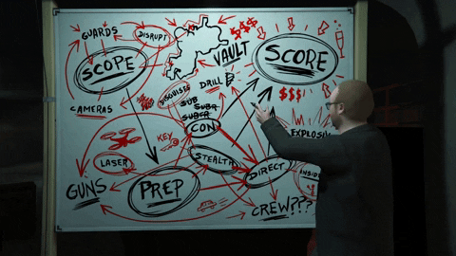
At End of 2 Months: Implementation Milestone By the end of the second month, the goal is to have 25% of the implementation completed. This milestone includes a functional system with integrated modules for object detection, intent prediction of pedestrians, drivable area segmentation, vehicle re-identification, and high-performance object tracking. The system should be capable of processing and analyzing real-time video data from various sources, showcasing advancements in optimizing road traffic management.
This proposed plan balances the need for meticulous development with the urgency of achieving a significant implementation milestone within the specified timeframe, laying the foundation for the subsequent phases of the project.

Slide 17
REFERENCES
Shen, Anting. "Beaverdam: Video annotation tool for computer vision training labels." EECS Department, University of California, Berkeley, Master Thesis (2016).
Jensen, Morten Bornø, et al. "A framework for automated traffic safety analysis from video using modern computer vision." Transportation Research Board Annual Meeting 2019. 2019.
Saleh, Khaled, Mohammed Hossny, and Saeid Nahavandi. "Real-time intent prediction of pedestrians for autonomous ground vehicles via spatio-temporal densenet." 2019 International Conference on Robotics and Automation (ICRA). IEEE, 2019.
Akhtar, Malik Javed, et al. "A Robust Framework for Object Detection in a Traffic Surveillance System." Electronics 11.21 (2022): 3425.
Cheng, Zhiwei, et al. "Dense-acssd for end-to-end traffic scenes recognition." 2019 IEEE Intelligent Vehicles Symposium (IV). IEEE, 2019.
Yan, Ke, et al. "Exploiting multi-grain ranking constraints for precisely searching visually-similar vehicles." Proceedings of the IEEE international conference on computer vision. 2017.
Lee, Sangrok, et al. "Strdan: Synthetic-to-real domain adaptation network for vehicle re-identification." Proceedings of the IEEE/CVF conference on computer vision and pattern recognition workshops. 2020.
Wang, Qiang, et al. "Learning attentions: residual attentional siamese network for high performance online visual tracking." Proceedings of the IEEE conference on computer vision and pattern recognition. 2018.
Albacar, Pol, et al. "Video Surveillance for Road Traffic Monitoring." arXiv preprint arXiv:2105.04908 (2021).
Roy, Debaditya, et al. "Detection of collision-prone vehicle behavior at intersections using siamese interaction lstm." IEEE transactions on intelligent transportation systems 23.4 (2020): 3137-3147.

Slide 18
Liu, Yi, et al. "Multi-stream Siamese and faster region-based neural network for real-time object tracking." IEEE Transactions on Intelligent Transportation Systems 22.11 (2020): 7279-7292.
Choi, Chang, et al. "Sensored semantic annotation for traffic control based on knowledge inference in video." IEEE Sensors Journal 21.10 (2021): 11758-11768.
Leal-Taixé, Laura, Cristian Canton-Ferrer, and Konrad Schindler. "Learning by tracking: Siamese CNN for robust target association." Proceedings of the IEEE conference on computer vision and pattern recognition workshops. 2016.
Wei, Yuxiao, Yawen Hua, and Wei Xiang. "Research on Specific Long-term Single Object Tracking Algorithms in the Context of Traffic." Procedia Computer Science 214 (2022): 304-311.
Groh, Florian, Dominik Schörkhuber, and Margrit Gelautz. "A tool for semi-automatic ground truth annotation of traffic videos." Electronic Imaging 2020.16 (2020): 200-1.
Robles-Serrano, Sergio, German Sanchez-Torres, and John Branch-Bedoya. "Automatic detection of traffic accidents from video using deep learning techniques." Computers 10.11 (2021): 148.
Umair, Muhammad, et al. "Efficient video-based vehicle queue length estimation using computer vision and deep learning for an urban traffic scenario." Processes 9.10 (2021): 1786.
Šegvić, S., et al. "A computer vision assisted geoinformation inventory for traffic infrastructure." 13th international IEEE conference on intelligent transportation systems. IEEE, 2010.
Siogkas, George, Evangelos Skodras, and Evangelos Dermatas. "Traffic lights detection in adverse conditions using color, symmetry and spatiotemporal information." International Conference on Computer Vision Theory and Applications. Vol. 2. SCITEPRESS, 2012.
Yuan, Yuan, Zhitong Xiong, and Qi Wang. "An incremental framework for video-based traffic sign detection, tracking, and recognition." IEEE Transactions on Intelligent Transportation Systems 18.7 (2016): 1918-1929.
Luo, Hengliang, et al. "Traffic sign recognition using a multi-task convolutional neural network." IEEE Transactions on Intelligent Transportation Systems 19.4 (2017): 1100-1111.
Franklin, Ruben J. "Traffic signal violation detection using artificial intelligence and deep learning." 2020 5th international conference on communication and electronics systems (ICCES). IEEE, 2020.
Yu, Fisher, et al. "Bdd100k: A diverse driving video database with scalable annotation tooling." arXiv preprint arXiv:1805.04687 2.5 (2018): 6.

Slide 19
Hua, Shuai, Manika Kapoor, and David C. Anastasiu. "Vehicle tracking and speed estimation from traffic videos." Proceedings of the IEEE Conference on Computer Vision and Pattern Recognition Workshops. 2018.
Màrmol, Elena, and Xavier Sevillano. "QuickSpot: a video analytics solution for on-street vacant parking spot detection." Multimedia Tools and Applications 75 (2016): 17711-17743.

Slide 20


